Slide 1
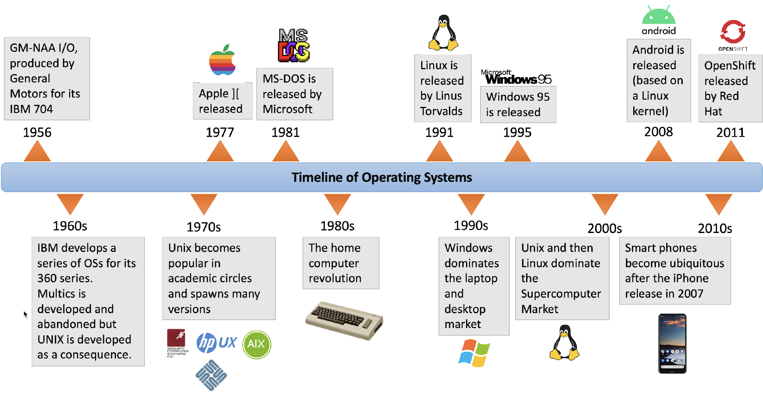
Timeline of OS

Slide 2
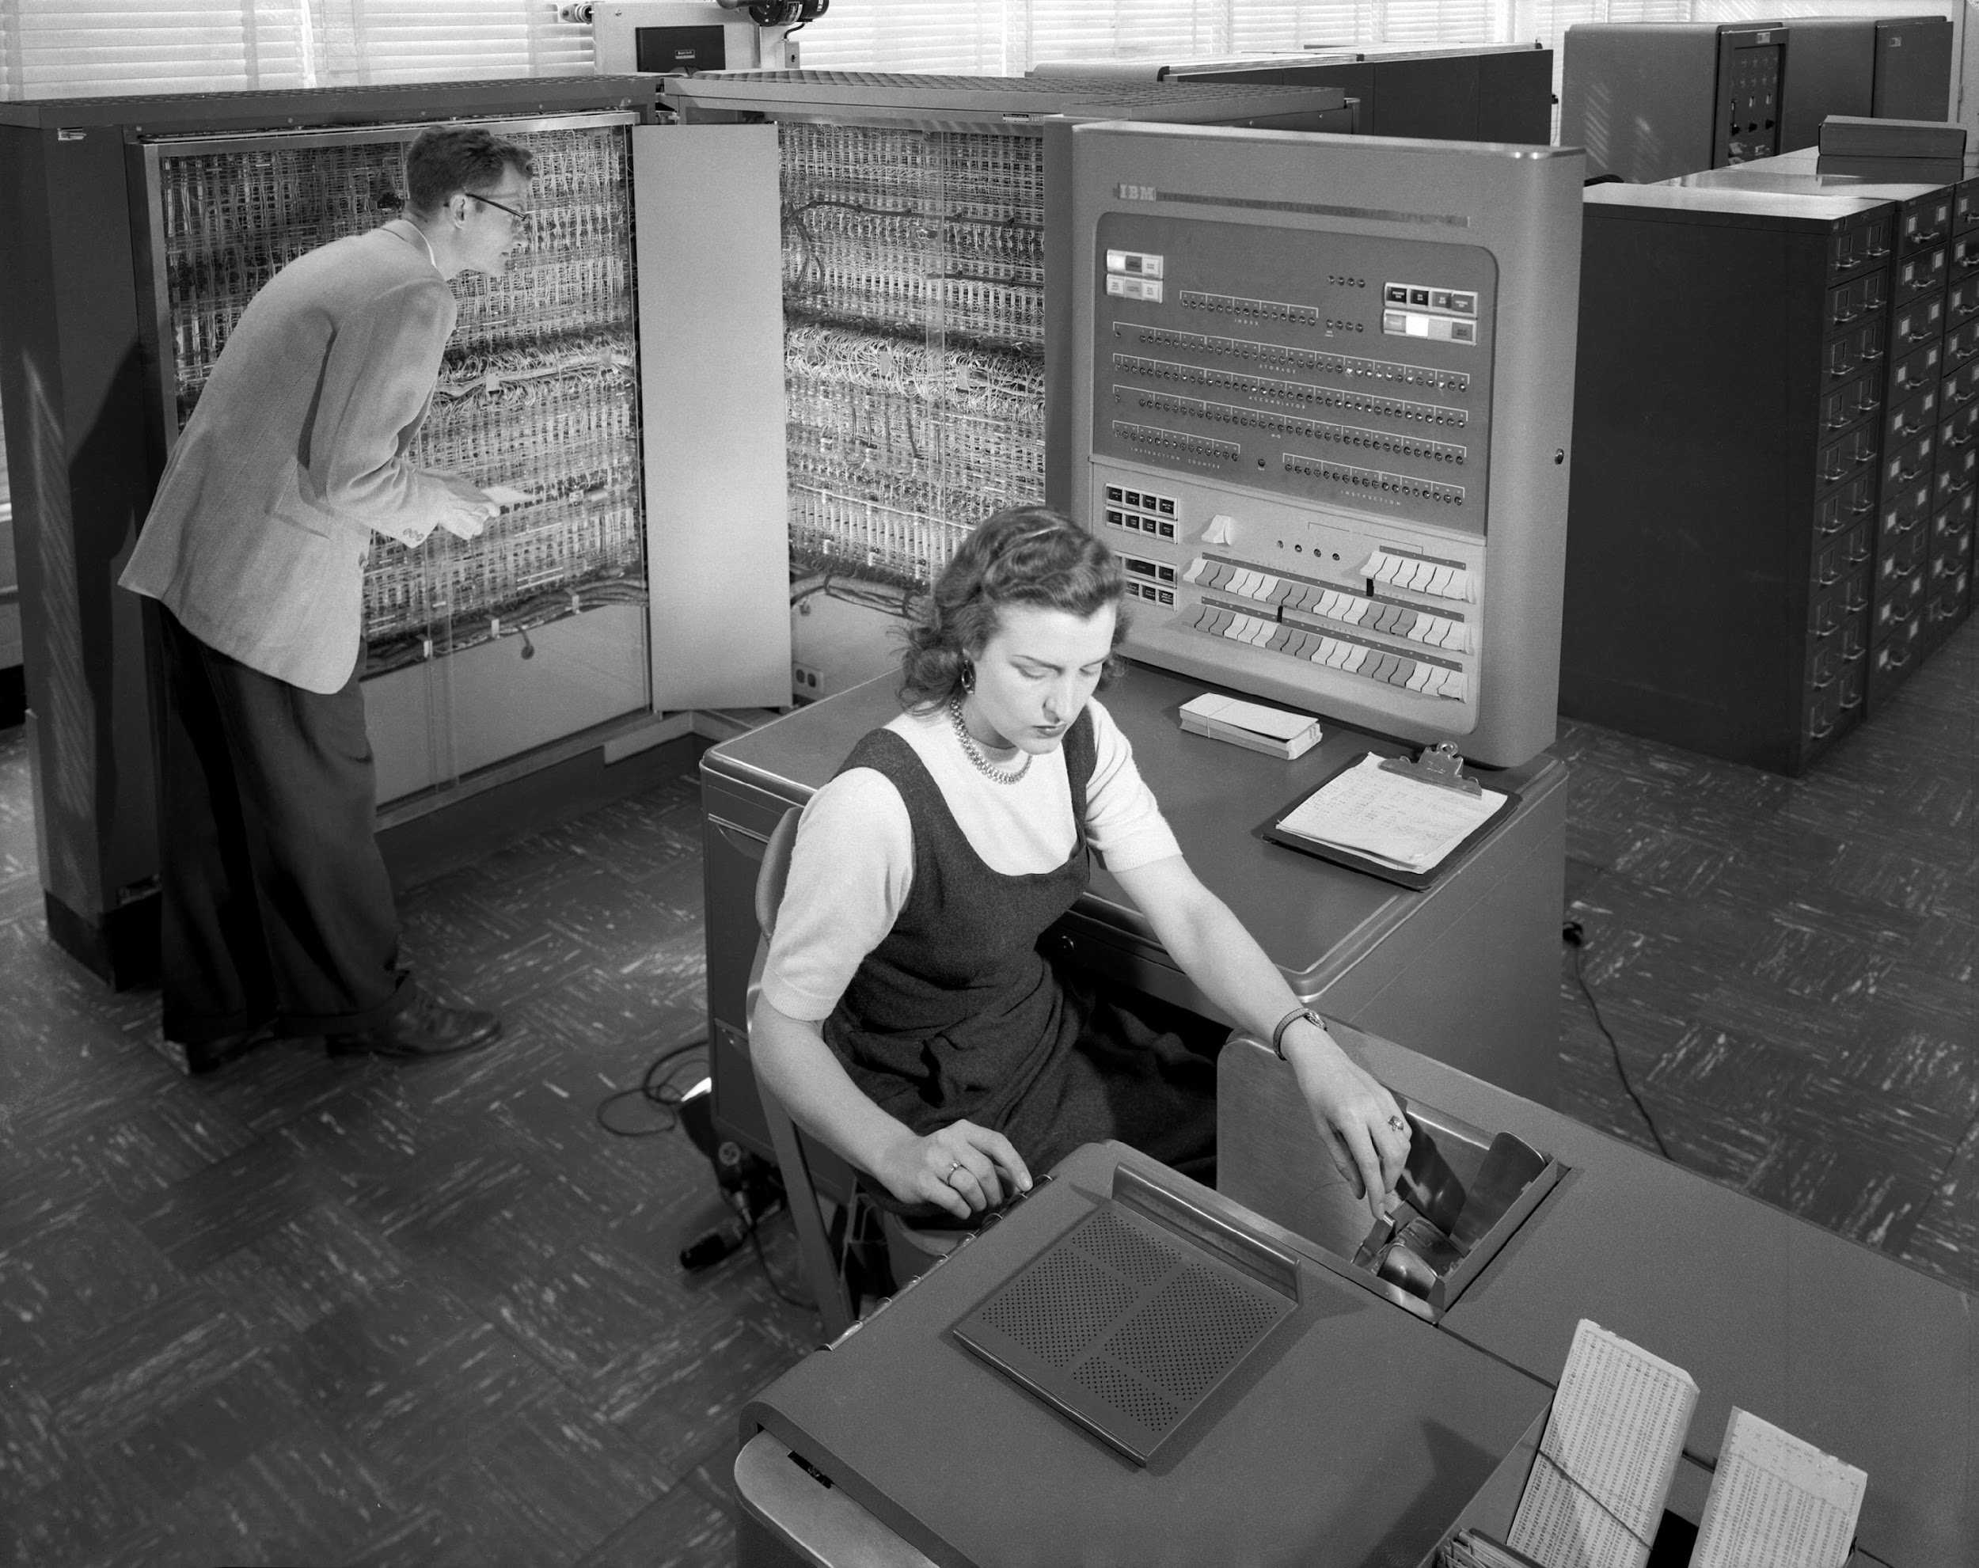
Timeline of OS
IBM 704 was the first mass-produced computer
GM-NAA (General Motors-North American Aviation) I/O is the OS used in the IBM 704
There was no UI in the OS as we know now
It was mostly based on command prompts (terminals)

Slide 3
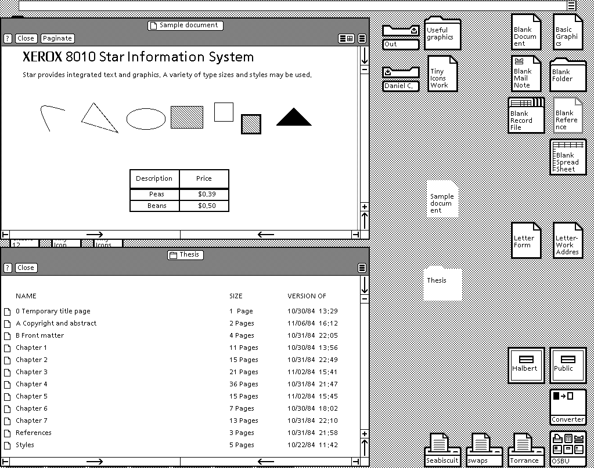
Timeline of OS
Xerox 8010 Star (released in 1981) was the first system that was referred to as a fully integrated desktop computer including applications and a GUI

Slide 4
Timeline of OS
Bill Gates got lucky to sign the so-called “Deal of the Century” with IBM to design a new OS for IBM machines
The deal allowed Microsoft to add an OS with $50 per PC and IBM did not own copyright for the OS
This allowed Microsoft to start the their OS dominance on the PC domain

Slide 5
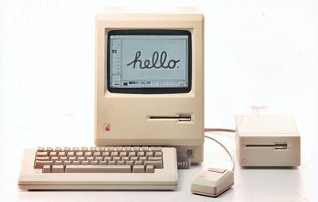
Timeline of OS
Developed by Apple Computer, Inc for their new product, the Macintosh home PC, The Macintosh 128K, was released in 1984
was widely advertised (the famous 1984 commercial is available below).
Mac OS was the first OS with a GUI built-in
It was also one of the first consumer computers with mouse!
Even though Microsoft introduced mouse in their PCs a bit earlier
The use of GUI with mouse was not Steve Job’s idea, the idea was taken during his visit in Xerox PARC (Palo Aalto Research Center)
Jobs reportedly traded US $1 million in stock options to Xerox for a detailed tour of their facilities and current projects
One of the things Xerox showed Jobs was the Alto, which sported a GUI and a three-button mouse

Slide 6
Operating Systems
OS Architecture
FBA

Slide 7
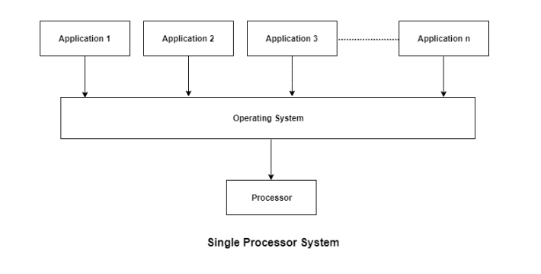
Operating System Architecture
Single-Processor Systems:
One main CPU capable of executing a general-purpose instruction set.
Almost all single processor systems have other special-purpose processors (device-specific processors), which run a limiter instruction set.

Slide 8
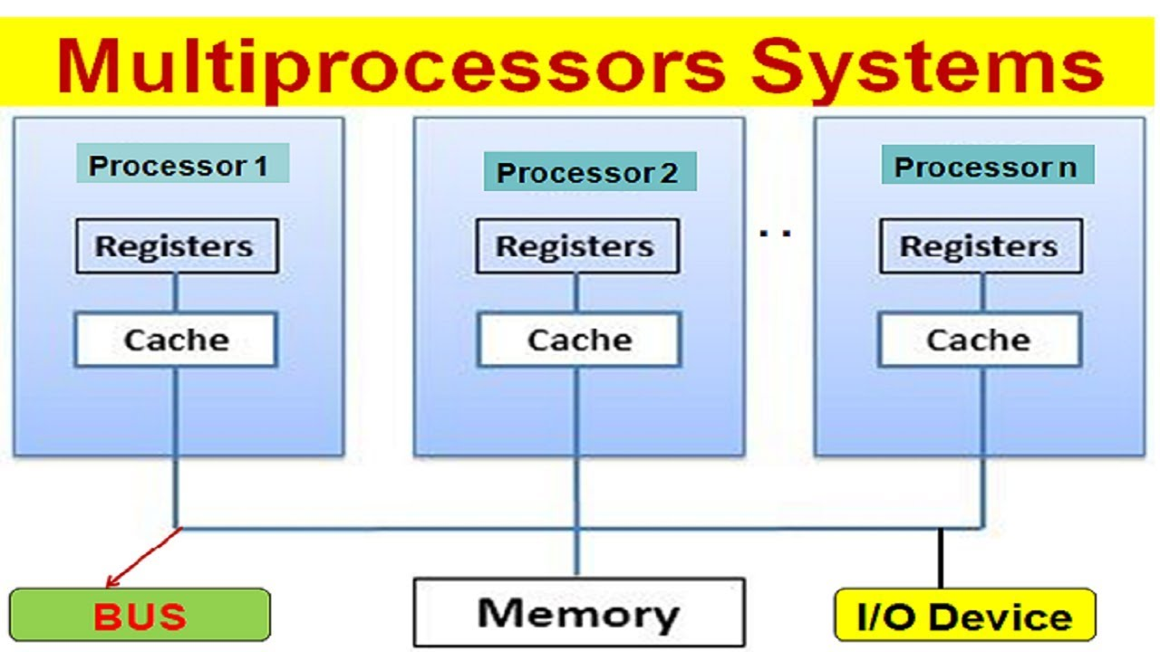
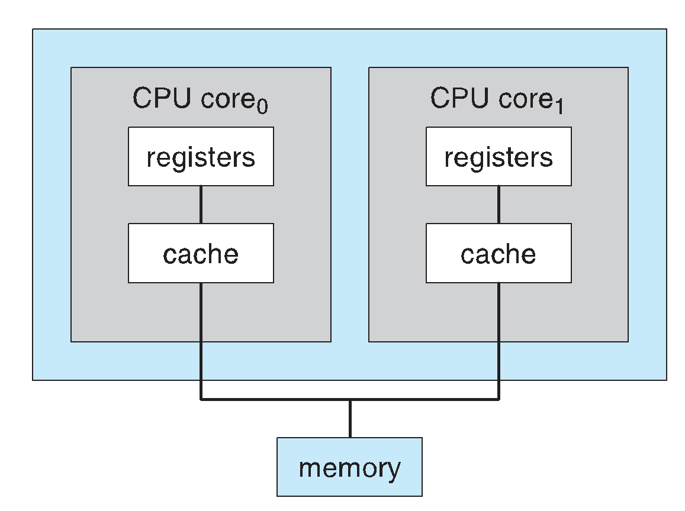
Operating System Architecture
Multiprocessor Systems (parallel systems or multicore systems ):
Such systems have two or more processors in close communication, sharing the computer bus and sometimes the clock, memory, and peripheral devices.
A dual-core system

Slide 9
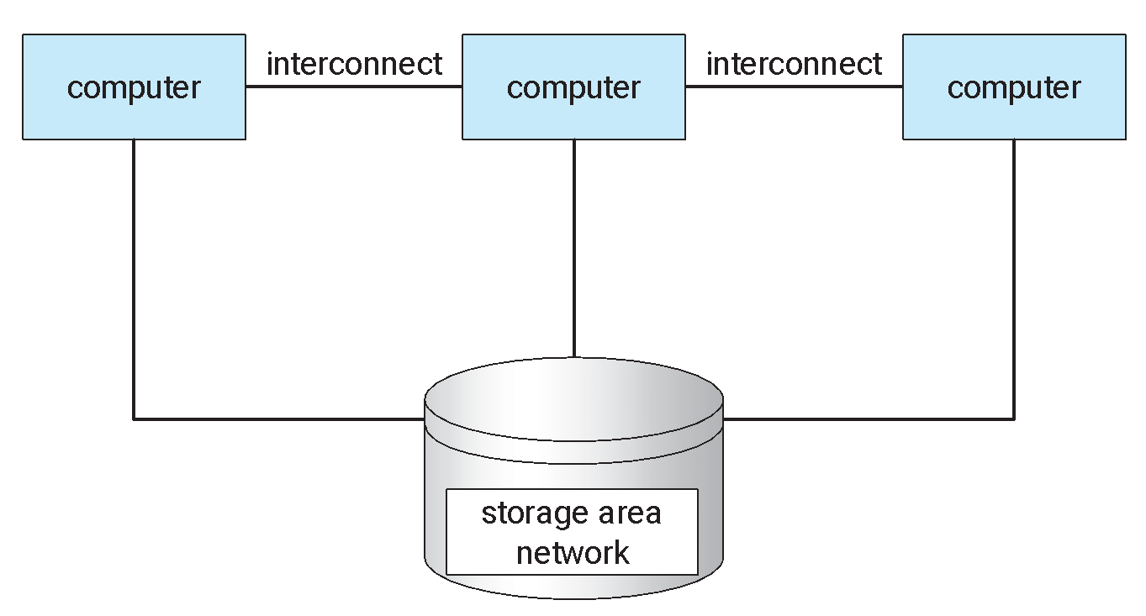
Operating System Architecture
Clustered Systems:
Special kind of multiprocessor system which gathers together multiple CPUs. They are composed of two or more individual systems- or nodes - joined together.
Clustered computers share storage and are closely linked via a local-area network (LAN) or a faster interconnect, such as InfiniBand

Slide 10
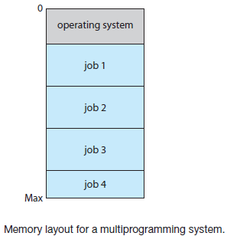
Operating System Structure
Multiprogramming:
Increases CPU utilization by organizing jobs (code and data) so that the CPU always has one to execute.
OS keeps several jobs in memory simultaneously. As main memory is small, it keeps the jobs on the disk (job pool) which waits there to be allocated in the main memory.
OS picks and begins to execute one of the jobs in memory. Eventually, the job may have to wait for some task. OS picks another job from the pool to execute while the previous one waits.

Slide 11
Requirements of Multiprogramming
Job Scheduling: If several jobs are ready to be brought into memory, and if there is not enough room for all of them, then the system must choose among them.
When OS selects a job from the job pool, it loads that job into memory for execution. Having several programs in memory at the same time requires some form of memory management.
CPU Scheduling: if several jobs are ready to run at the same time, the system must choose which job will run first.
Running multiple jobs concurrently requires that their ability to affect one another be limited in all phases of the operating system.
If processes don’t fit in memory, swapping moves them in and out to run from main memory achieving this goal is virtual memory.

Slide 12
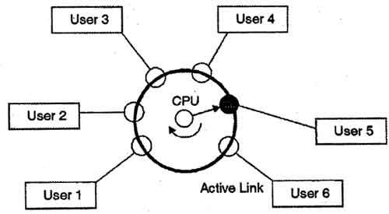
Operating System Structure
Time Sharing:
CPU executes multiple jobs by switching among them.
Switches occur so frequently that the users can interact with each program while it is running.
requires an interactive computer system, which provides direct communication between the user and the system.
Response time should be short.

Slide 13
Operating System Operations
Modern operating systems are interrupt driven
Events are almost always signaled by the occurrence of an interrupt or a trap
A trap (or an exception) is a software-generated interrupt
For each type of interrupt, separate segments of code determine what action should be taken
Errors can occur when one erroneous program modify another program, the data of another program, or even the operating system itself.
A properly designed operating system must ensure that an incorrect (or malicious) program cannot cause other programs to execute incorrectly.

Slide 14
Types of System Call
Type | Windows OS | Linux OS
Process Control | CreateProcess() ExitProcess() WaitForSingleObject() | fork() exit() wait()
File Manipulation | CreateFile() ReadFile() WriteFile() CloseHandle() | open() read() write() close()
Device Manipulation | SetConsoleMode() ReadConsole() WriteConsole() | ioctl() read() write()

Slide 15
Types of System Call
Type | Windows OS | Linux OS
Information Maintenance | GetCurrentProcessID() SetTimer() Sleep() | getpid() alarm() sleep()
Communication | CreatePipe() CreateFileMapping() MapViewOfFile() | pipe() shm_open() mmap()
Protection | SetFileSecurity() InitlializeSecurityDescriptor() SetSecurityDescriptorGroup() | chmod() umask() chown()

Slide 16
System Programs
System programs, also known as system utilities, provide a convenient environment for program development and execution.
These system programs provide -
File management
Status information
File modification
Programming-language support
Program loading and execution
Communications
Background services

Slide 17
System Boot
When power initialized on system, execution starts at a fixed memory location.
Firmware ROM used to hold initial boot code
Operating system must be made available to hardware so hardware can start it.
Small piece of code – bootstrap loader, stored in ROM locates the kernel, loads it into memory, and starts it
Sometimes two-step process where boot block at fixed location loaded by ROM code, which loads bootstrap loader from disk
Common bootstrap loader, GRUB, allows selection of kernel from multiple disks, versions, kernel options
Kernel loads and system is then running.

Slide 18
Operating Systems
OS Structures
FBA

Slide 19
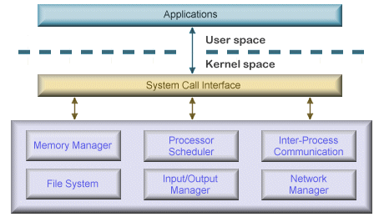
OS Structure
Simple/Monolithic structure:
Earliest and most common architecture
Every component of OS is in the kernel and can communicate with each other directly
Complex and Large ( millions line of code , ) hard to maintain

Slide 20
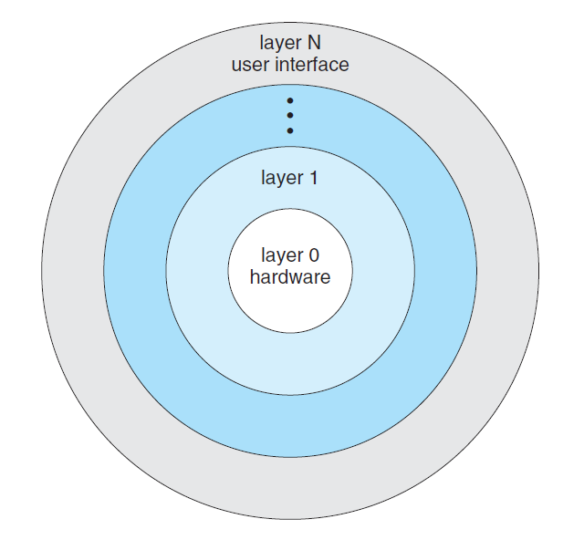
OS Structure
Layered structure:
OS is divided into layers.
Each layer can use services of its lower layers.
Easy to debug and develop.
Less efficient as each layer adds some overhead

Slide 21
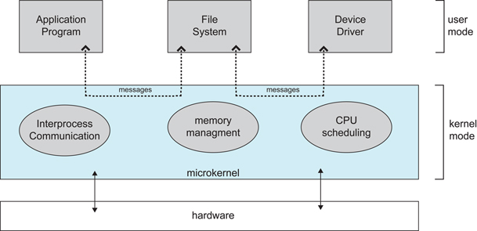
OS Structure
Microkernel structure:
Moves as much from kernel into user space
Communication takes place between user modules using message passing
Easier to extend a microkernel
More reliable( less code running in kernel mode ) and secure
Performance overhead

